Slide 1
Data Acquisition
Pre processing
Feature Extraction
Data Modeling
Advisory
Outlier detection/removal
Missing Value
..
Historical Data
Variable importance
Correlation Analysis
Causality Analysis
PCA
..
Cleaning
Cleaned Data
Feature Engineering
Linear Regression
Artificial Neural Network
Non linear regression
Decision Tree
Cubist
..
Training Data
Cross Validation
Testing Data
Training
Trained Model
Validated Model
Expected Output

Slide 2
Data Acquisition
Pre processing
Feature Extraction
Data Modelling
Advisory
Current and Historical business data
..
Outlier removal
Missing Value
Resolve inconsistency
Smoothening noisy data
Normalization
..
Variable importance
Correlation Analysis
Causality Analysis
PCA..
Linear Regression
Artificial Neural Network
Non linear regression
Decision Tree
Cubist.
Cleaning
Historical
Data
Training Data
Training
Feature Engineering
Expected Output
Cleaned Data
Testing Data
Trained Model
Cross Validation

Slide 3
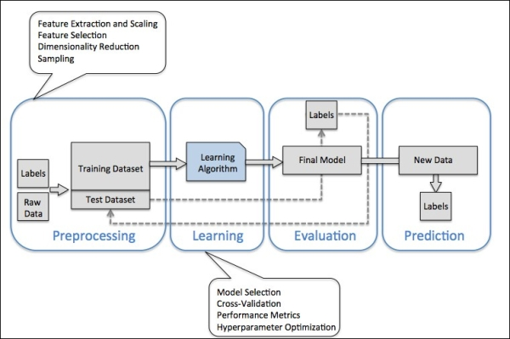

Slide 4
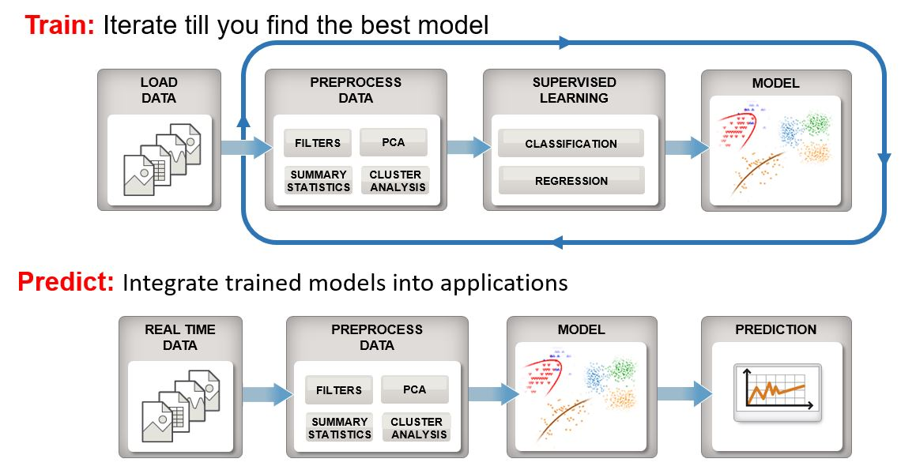

Slide 5
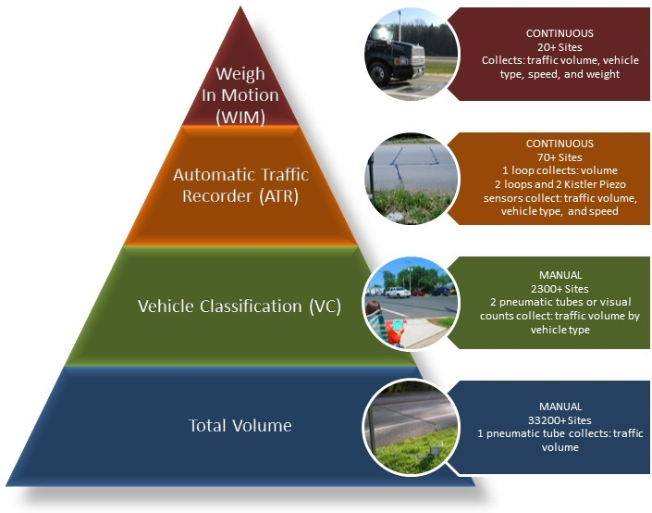

Slide 6
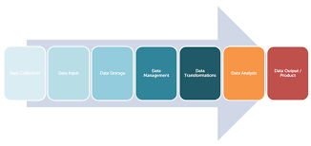
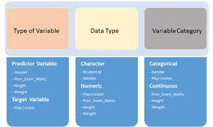

Slide 7
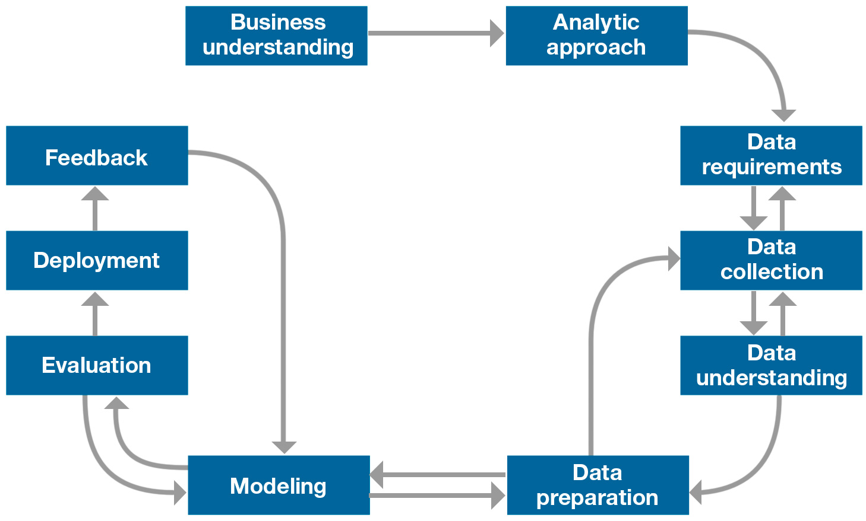

Slide 8
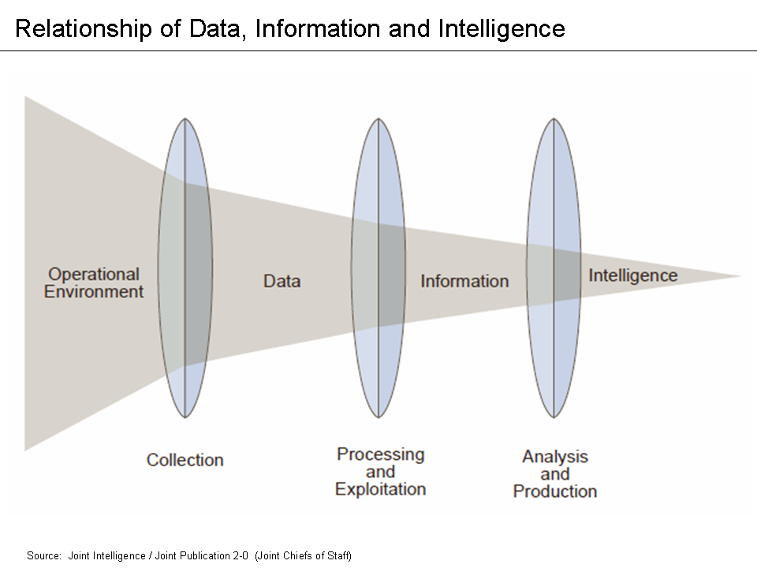

Slide 9
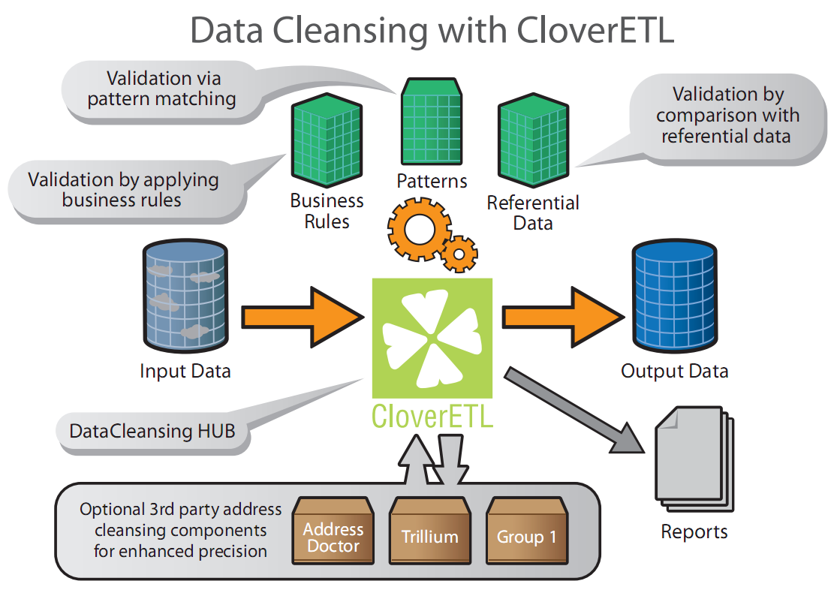

Slide 10
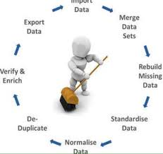

Slide 11
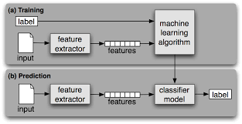

Slide 12
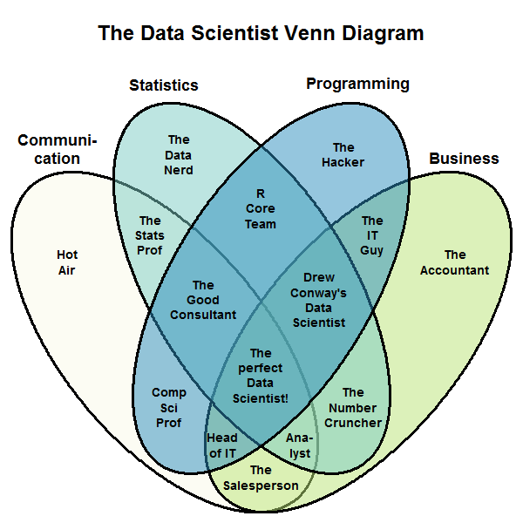

Slide 13
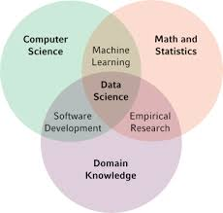

Slide 14


